Slide 1

LINEAR CONTROL
SYSTEMS
Ali Karimpour
Assistant Professor
Ferdowsi University of Mashhad
Notes:
<<<1.1>>>
###Control System Design###
{{{Control, Design}}}

Slide 2
Lecture 4
Converting of different representations of control systems
Topics to be covered include:
Mason’s flow graph loop rule (Converting SD to TF)
Realization (Converting TF to SS model)
Converting high order differential equation to state space

Slide 3
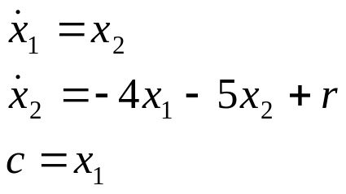

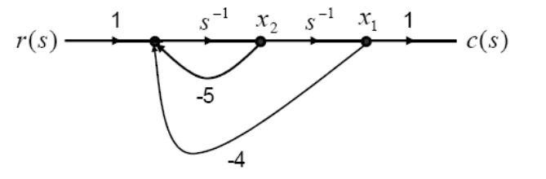
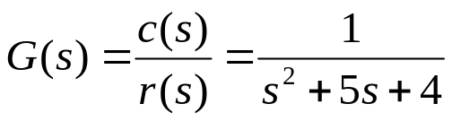
Different representations
نمايشهای مختلف
HODE
SS
Realization
SD
TF
Mason’s rule
Discussed in the last lecture
Will be discussed in this lecture

Slide 4
Mason’s flow graph loop rule
فرمول بهره ميسون
SD
TF
Mason’s rule

Slide 5
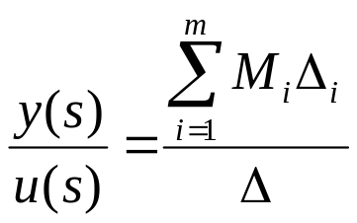
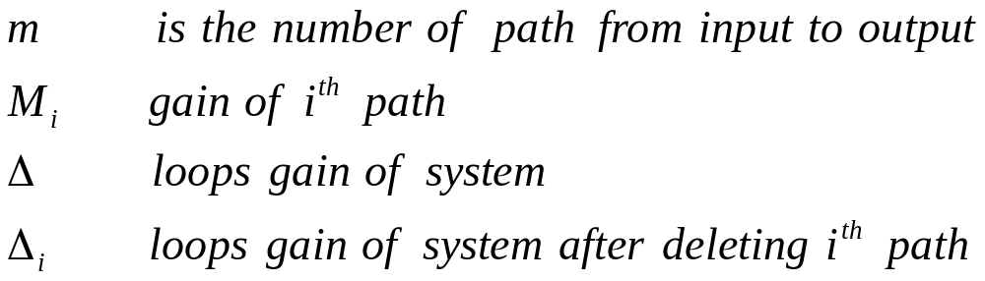
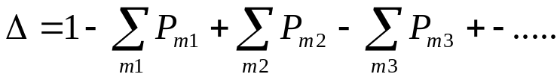
Mason’s flow graph lop rule
قانون گين ميسون

Slide 6
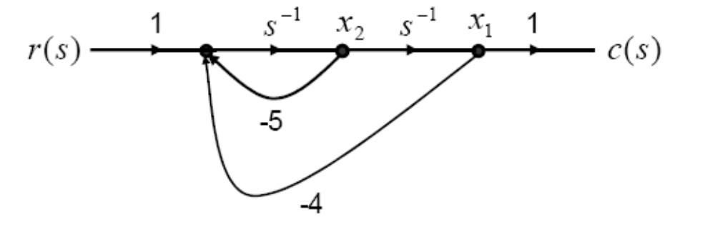
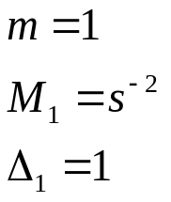
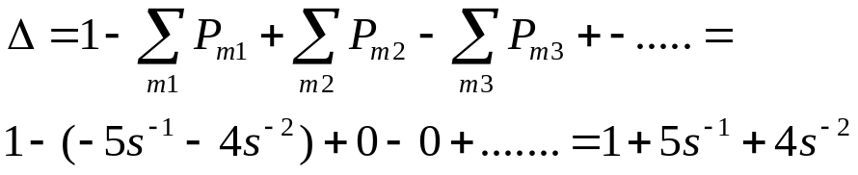
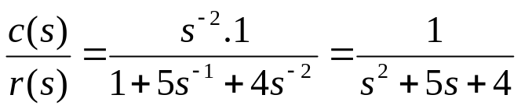
Example 1
مثال 1
Note

Slide 7
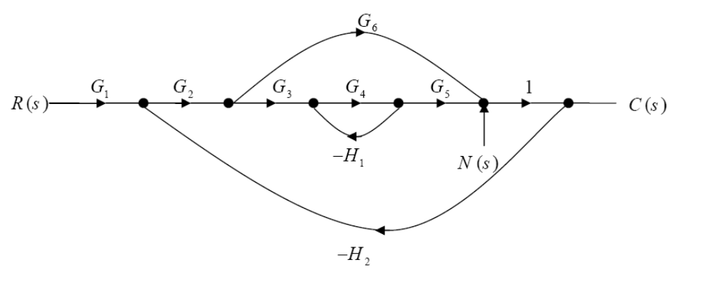
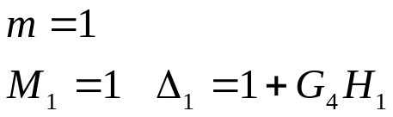
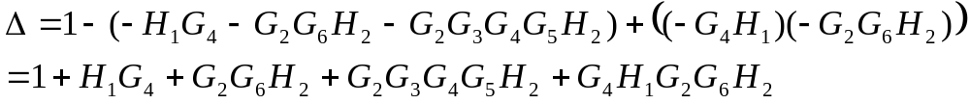
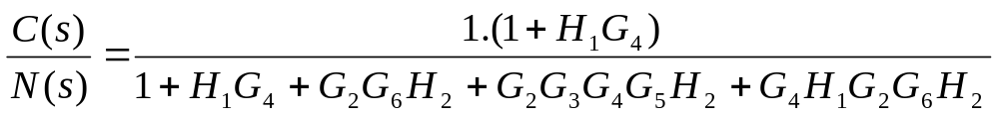
Example 2
مثال 2

Slide 8
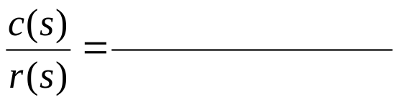
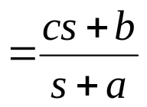
Example 3
مثال 3
Find the TF model for the following state diagram.
c
1
S⁻¹
b
r(s)
c(s)
-a
c.1
+ bs⁻¹.1
1+as⁻¹
This is a base form for order 1 transfer function.
اين يک حالت پايه برای تابع انتقال درجه 1 است

Slide 9
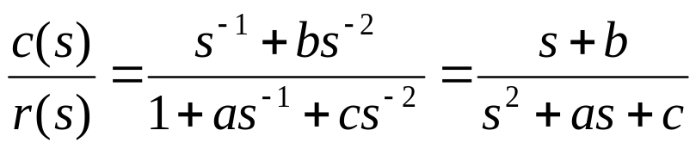
Example 3
مثال 3
Find the TF model for following state diagram.
1
1
S⁻¹
S⁻¹
b
r(s)
c(s)
-a
-c
This is a base form for order 2 transfer function.
اين يک حالت پايه برای تابع انتقال درجه 2 است

Slide 10
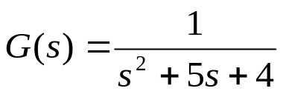
Realization
پياده سازی
TF
SS
Realization
SD

Slide 11
Realization
پياده سازی
Some Realization methods
چند روش پياده سازی
1- Direct Realization.
2- Series Realization.
3- Parallel Realization.
1- پياده سازی مستقيم
2- پياده سازی سری
3- پياده سازی موازی

Slide 12
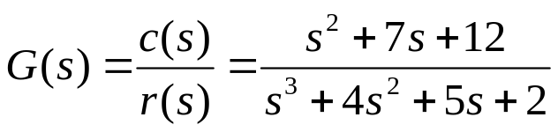
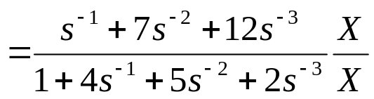

Direct Realization
پياده سازی مستقيم

Slide 13






Direct Realization
پياده سازی مستقيم
1
7
1
X
S⁻¹
x₃
S⁻¹
x₂
S⁻¹
x₁
12
r(s)
c(s)
-4
-5
-2

Slide 14
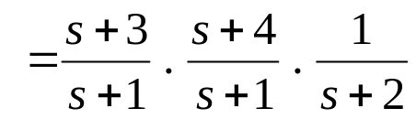
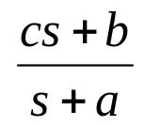
Series Realization
پياده سازی سري
c
1
S⁻¹
b
r(s)
c(s)
-a

Slide 15
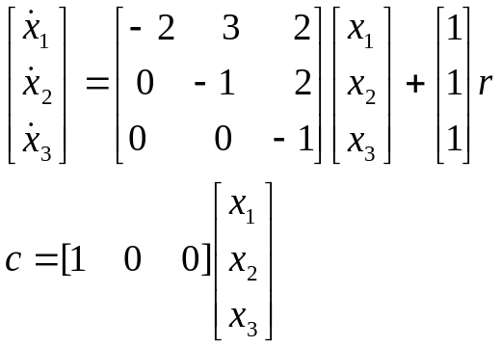




Series Realization
پياده سازی سري
c
1
S⁻¹
b
-a
r(s)
1
1
x₁
c(s)
S⁻¹
x₃
S⁻¹
x₂
1
3
1
4
1
S⁻¹
1
-1
-1
-2

Slide 16
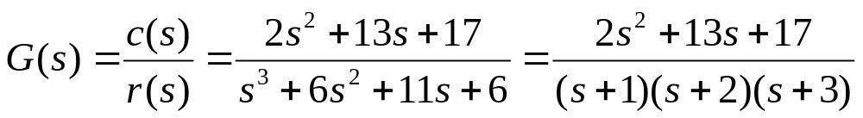
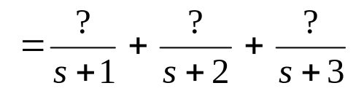
Parallel Realization
پياده سازی موازی
3
1
-2
c
1
S⁻¹
b
-a

Slide 17
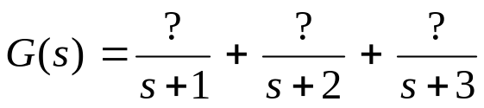
Parallel Realization
پياده سازی موازی
3
1
-2
S⁻¹
1
3
-1
r(s)
1
S⁻¹
-2
c(s)
1
-3
1
S⁻¹
c
-2
1
S⁻¹
b
-a

Slide 18




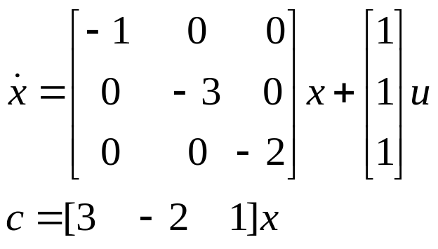
Parallel Realization
پياده سازی موازی
3
1
-2
S⁻¹
x₁
1
3
-1
r(s)
1
S⁻¹
x₂
-2
c(s)
1
-3
1
S⁻¹
x₃
-2

Slide 19
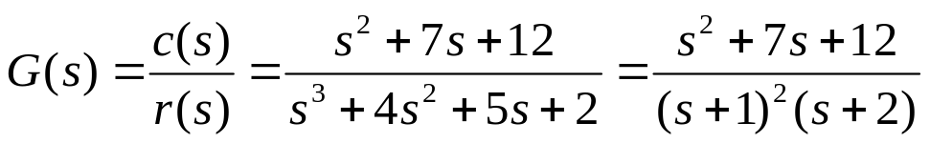
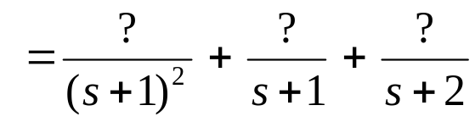

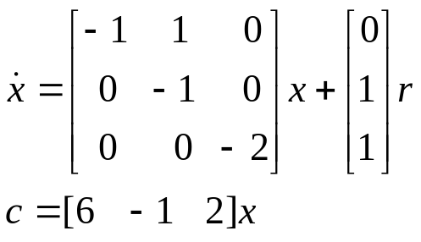



Parallel Realization
پياده سازی موازی
6
-1
2
x₂
x₁
S⁻¹
1
1
S⁻¹
1
-1
6
-1
-1
r(s)
1
S⁻¹
c(s)
x₃
2
-2
c(s)

Slide 20
Converting high order differential equation to state space
SS
HODE
TF

Slide 21
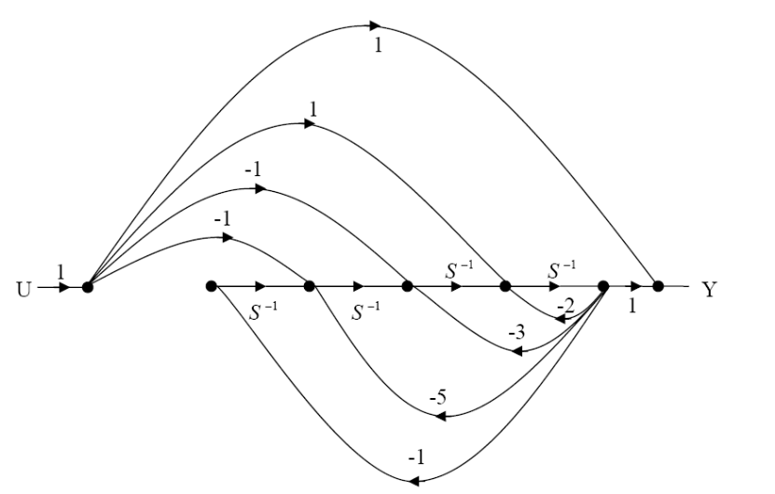
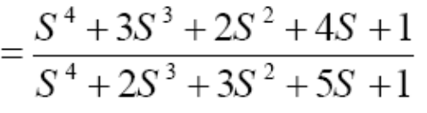
Exercises
تمرين
4-1 Find Y(s)/U(s) for following system
Ans

Slide 22
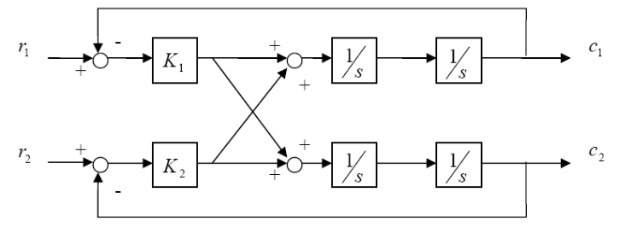
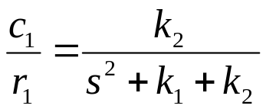
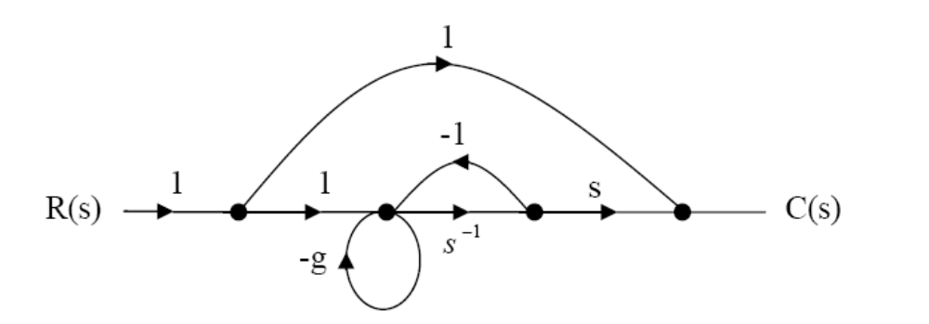
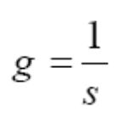
Exercises (Continue)
تمرين ادامه
4-2 Find c₁(s)/r₂(s) for following system
Answer
4-3 Find g such that C(s)/R(s) for following system is (2s+2)/s+2
Answer

Slide 23
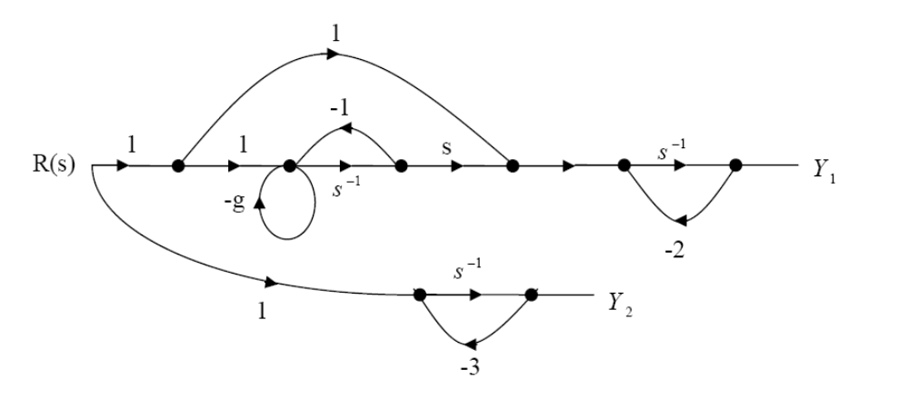
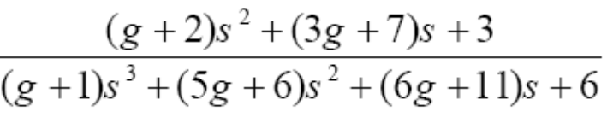
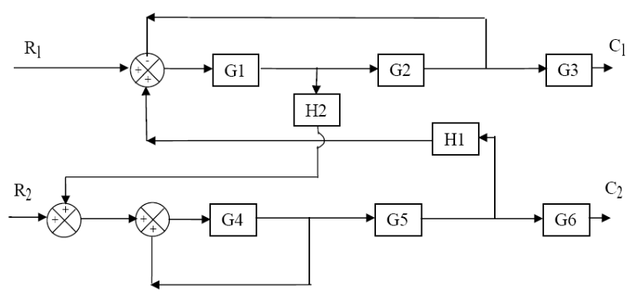
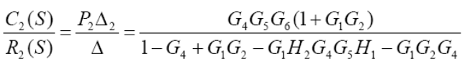

Exercises (Continue)
تمرين ادامه
4-4 Find Y₁(s)/R(s) for following system
Answer
4-5 Find C₁(s)/R₁(s) and C₂(s)/R₂(s) for following system
Answer

Slide 24
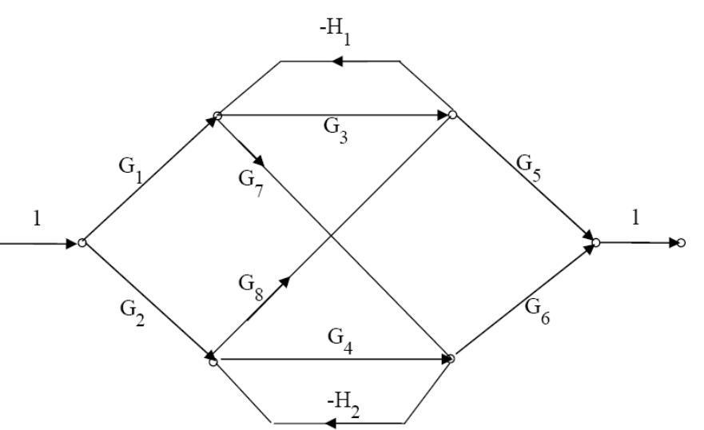
Exercises (Continue)
تمرين ادامه
4-6 Find C/R for following system
Answer

Slide 25

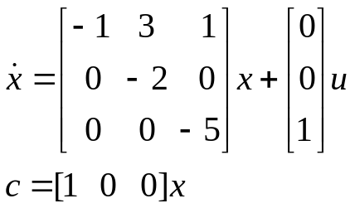
Exercises (Continue)
تمرين ادامه
4-7 Find the SS model for following system.
It was in some exams.
4-8 Find the TF model for following system without any inverse manipulation.
4-9 Find the SS model for following system.
G(s)

Slide 26
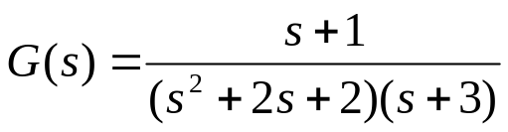
Exercises (Continue)
تمرين ادامه
4-10 Find direct realization, series realization and parallel realization for following system.
4-11 a) Find the transfer function of following system by Masson formula.
b) Find the state space model of system.
c) Find the transfer function of system from the SS model in part b
d) Compare part “a” and part “c”
c
S⁻¹
S⁻¹
1
r(s)
c(s)
-a
-b
It appears in many exams.*****

Slide 27
Exercises (Continue)
تمرين ادامه
4-12 a) Find the transfer function of following system by Masson formula.
b) Find the state space model of system.
c) Find the transfer function of system from the SS model in part b
d) Compare part “a” and part “c”
1
c
S⁻¹
S⁻¹
1
r(s)
c(s)
-a
-b
Regional Electrical engineering Olympiad spring 2008.*****

